Slide 1
CS425: Software Engineering

Slide 2
Lesson 12
Security

Slide 3
Wholeness
Software Security describes methodologies, framework, processes and strategies for enhancing security and reducing vulnerabilities within software and its execution environment.
Spring security offers a highly customizable authentication and access-control framework for Spring-based applications.
Science of Consciousness: Action leads to Achievement. Achievement leads to Fulfillment.

Slide 4
Aspects of Security
Authentication: process of verifying a user’s identity. Ascertaining that someone is who they claim to be (e.g. userID and password)
Authorization: mechanism for establishing access-level and granting appropriate rights and privileges.
Cryptography: Techniques for securing communication through Data encryption

Slide 5
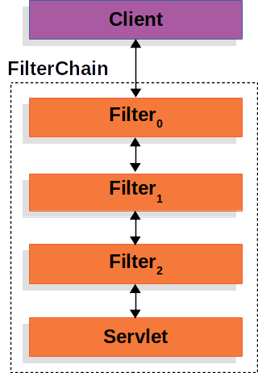
Key Concepts in Spring Security
SpringSecurityFilterChain: For Servlet-driven Spring web applications, the Filter chain plays the central role for securing a given HTTP Request URI path.
Spring Boot Auto Configuration: Simply adding the dependency named, spring-boot-starter-security, enables default config

Slide 6
Types of Authentication Mechanisms supported by Spring Security
HTTP Basic Authentication: enabled in HTTP server or Servlet container
Form-based, custom Database Authentication: Where we use a Database to store/authenticate the user credentials.
LDAP-driven Authentication. e.g. Microsoft Windows Active Directory service
OAuth/OpenID Connect Authentication e.g. Login with Google or Microsoft or Github or Facebook account
Token-based Authentication: Using JSON web token (JWT)

Slide 7
Spring Security API
AuthenticationManager: is an interface with just one method named, authenticate, which processes an Authentication request.
AuthenticationProvider: an interface that can be implemented by one or more classes that provider Authentication service using a given authentication mechanism e.g. DaoAuthenticationProvider, LdapAuthenticationProvider, JwtAuthenticationProvider etc.

Slide 8
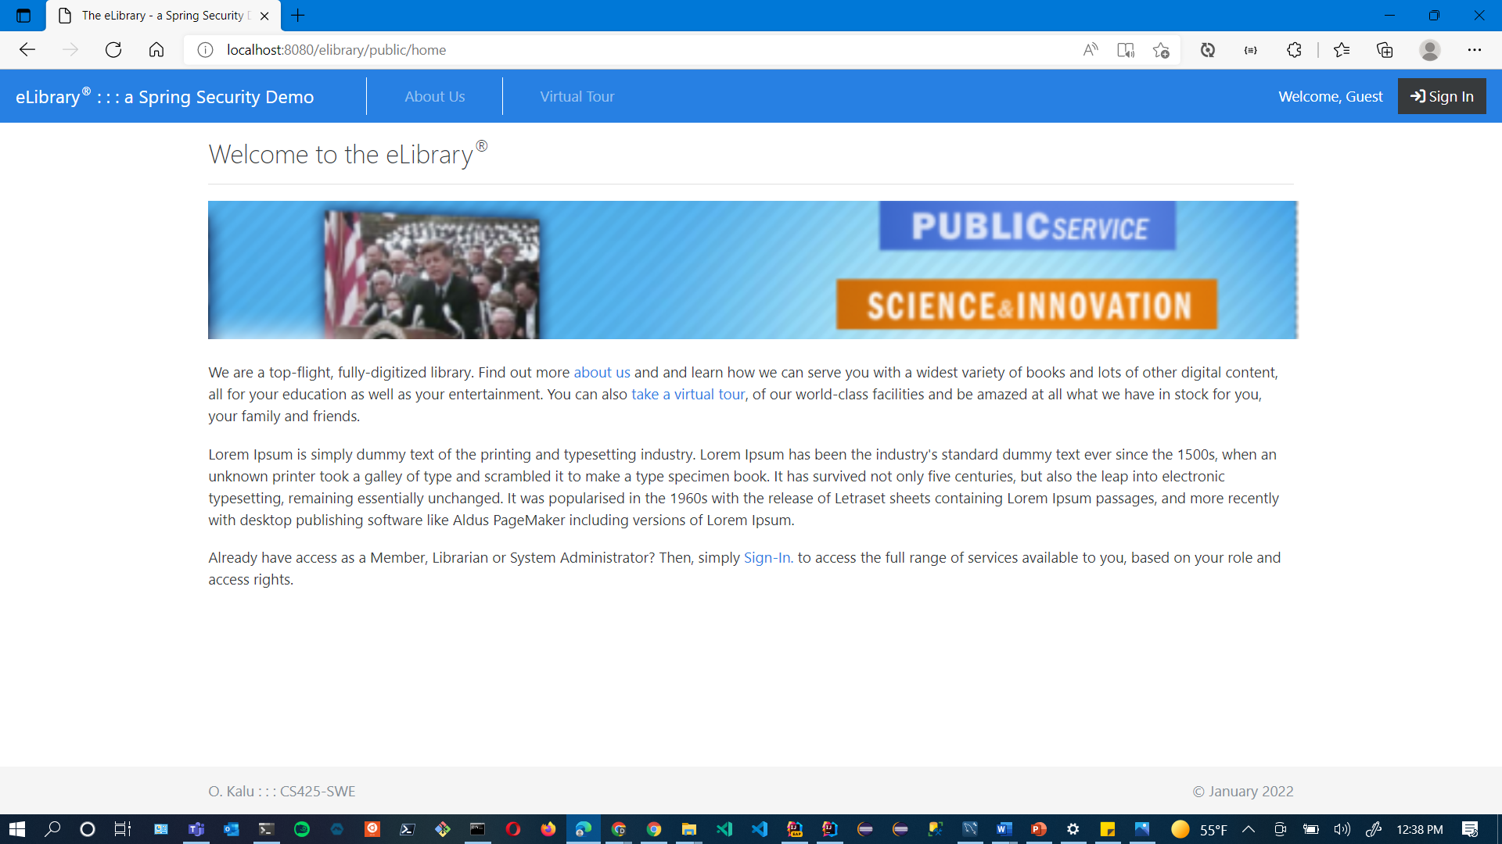
Implementing Spring Security for a webapp – Coding Demo

Slide 9
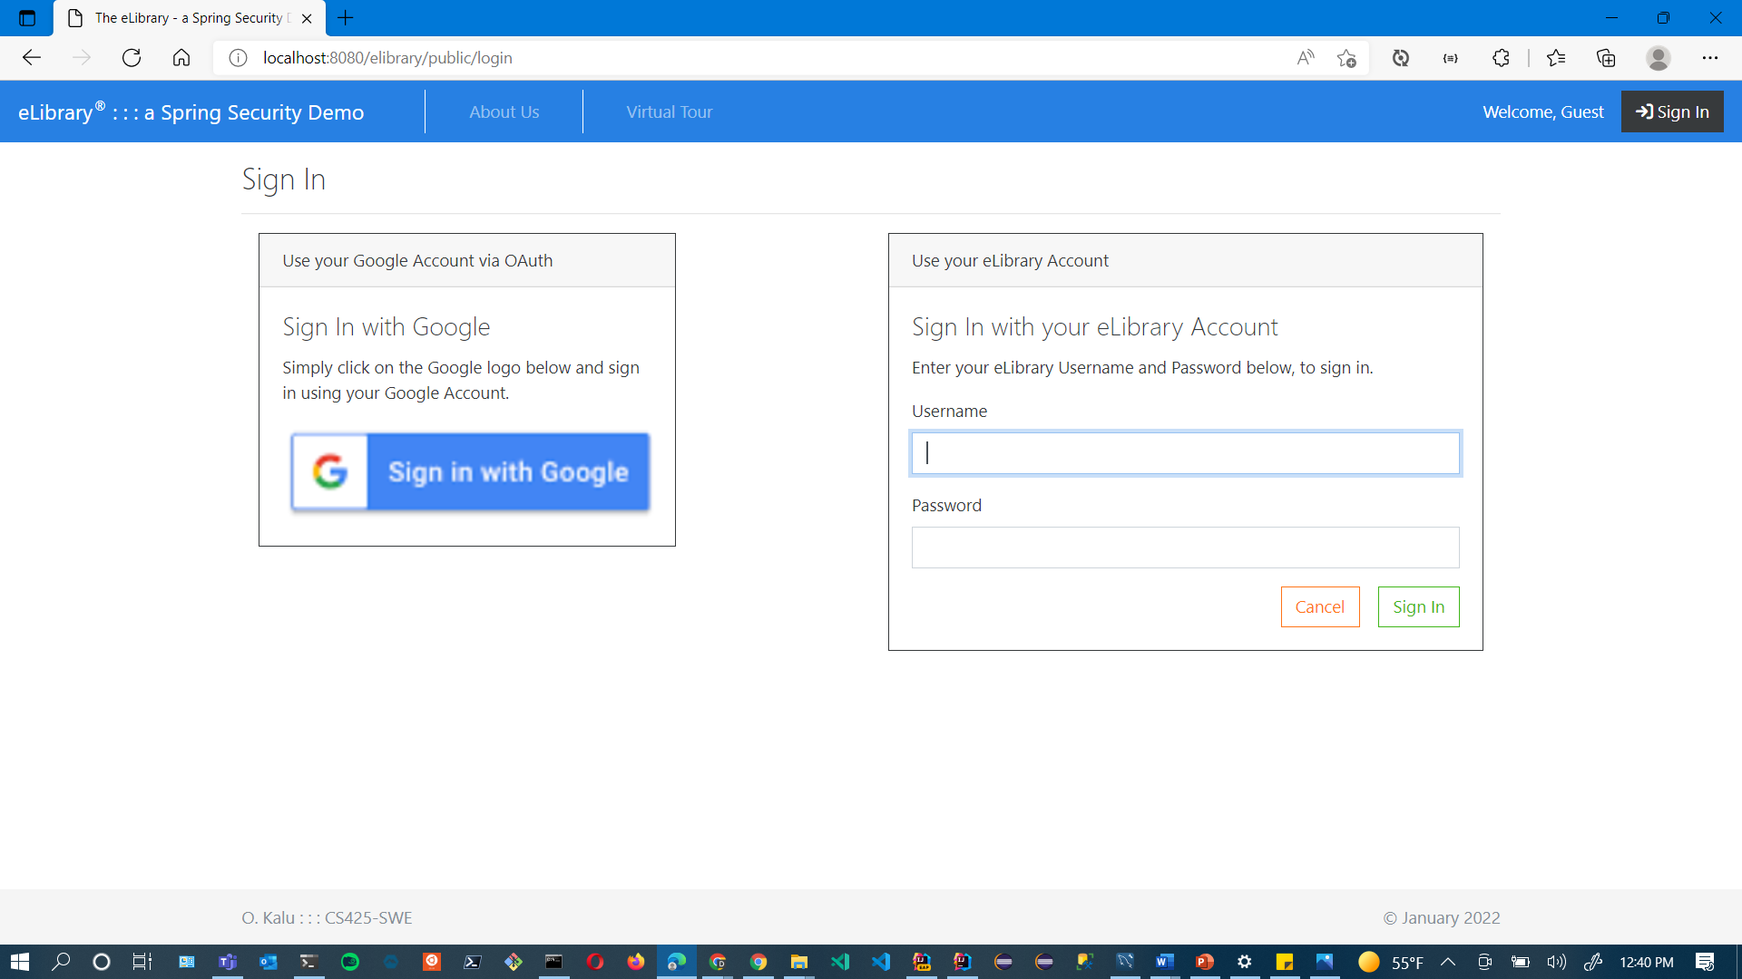
Implementing Spring Security for a webapp – Coding Demo

Slide 10
CS425: Software Engineering

